Slide 1
International Cooperation and Space Investment
Beyond Citizens’ Daily Lives
Team: Crazy Thursday
Team Members:Yanqiu Hu, Yuan Yao, Peiye Li, Qihao Bu

Slide 2
Agenda
Motivation& Researchquestion
Finding
Data & Methods
Nulla non rhoncus purus da item
International Cooperation
Nulla non rhoncus purus da item
Launch V.S. Price level
Nulla non rhoncus purus da item
Outcome
Nulla non rhoncus purus da item

Slide 3
International cooperation
Citizens’ living quality
Countries like U.S., Rasia not only dominate in launch frequency, but also rely heavily on partnerships with others, especially in the International Space Station era. This highlights the strategic role of collaboration in sustaining modern spaceflight.
We then asked whether governments adjust space activity based on economic well-being at home.
If inflation soars, do launches decline?
If living costs rise, does investment shift away from rockets?

Slide 4
Motivation& Researchquestion
RQ1: Is there a relationship between citizens’ financial well-being (CPI, cost of living) and annual space launches?
RQ2: Does international cooperation accelerate space activity, and can cooperation rather than competition drive the future of space exploration?

Slide 5
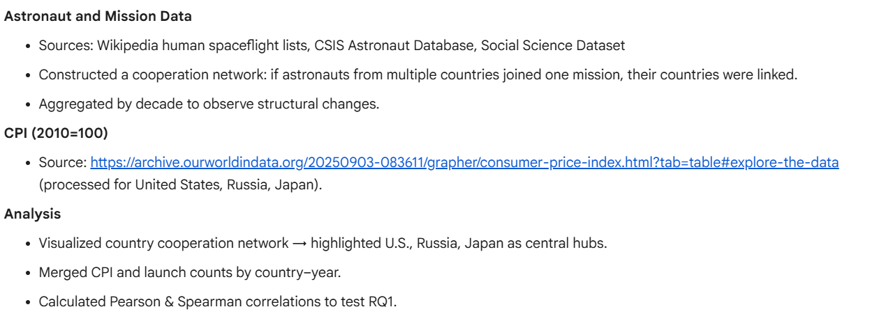
Data & Methods
subtitle

Slide 6
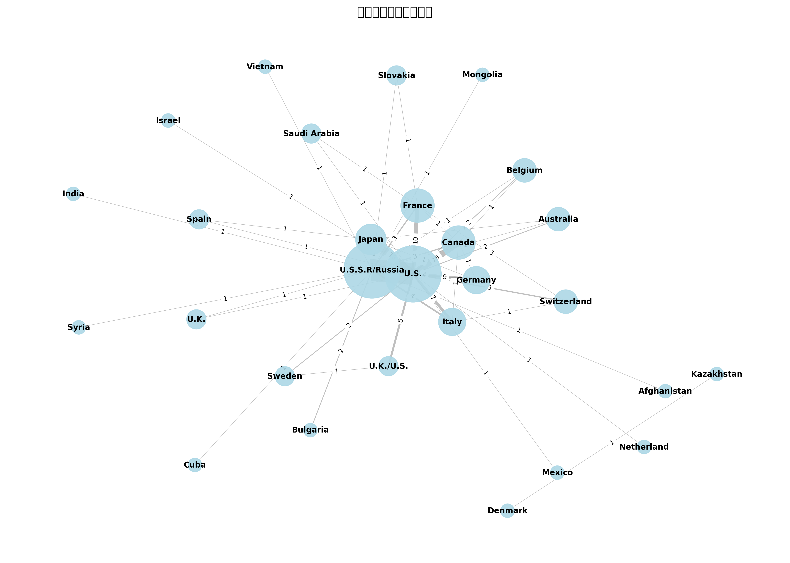
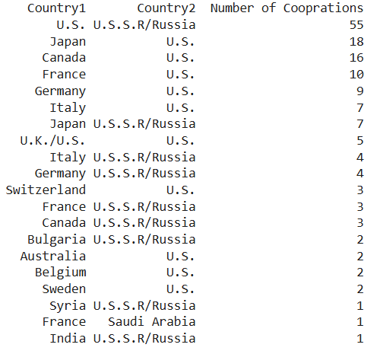
International Cooperation

Slide 7
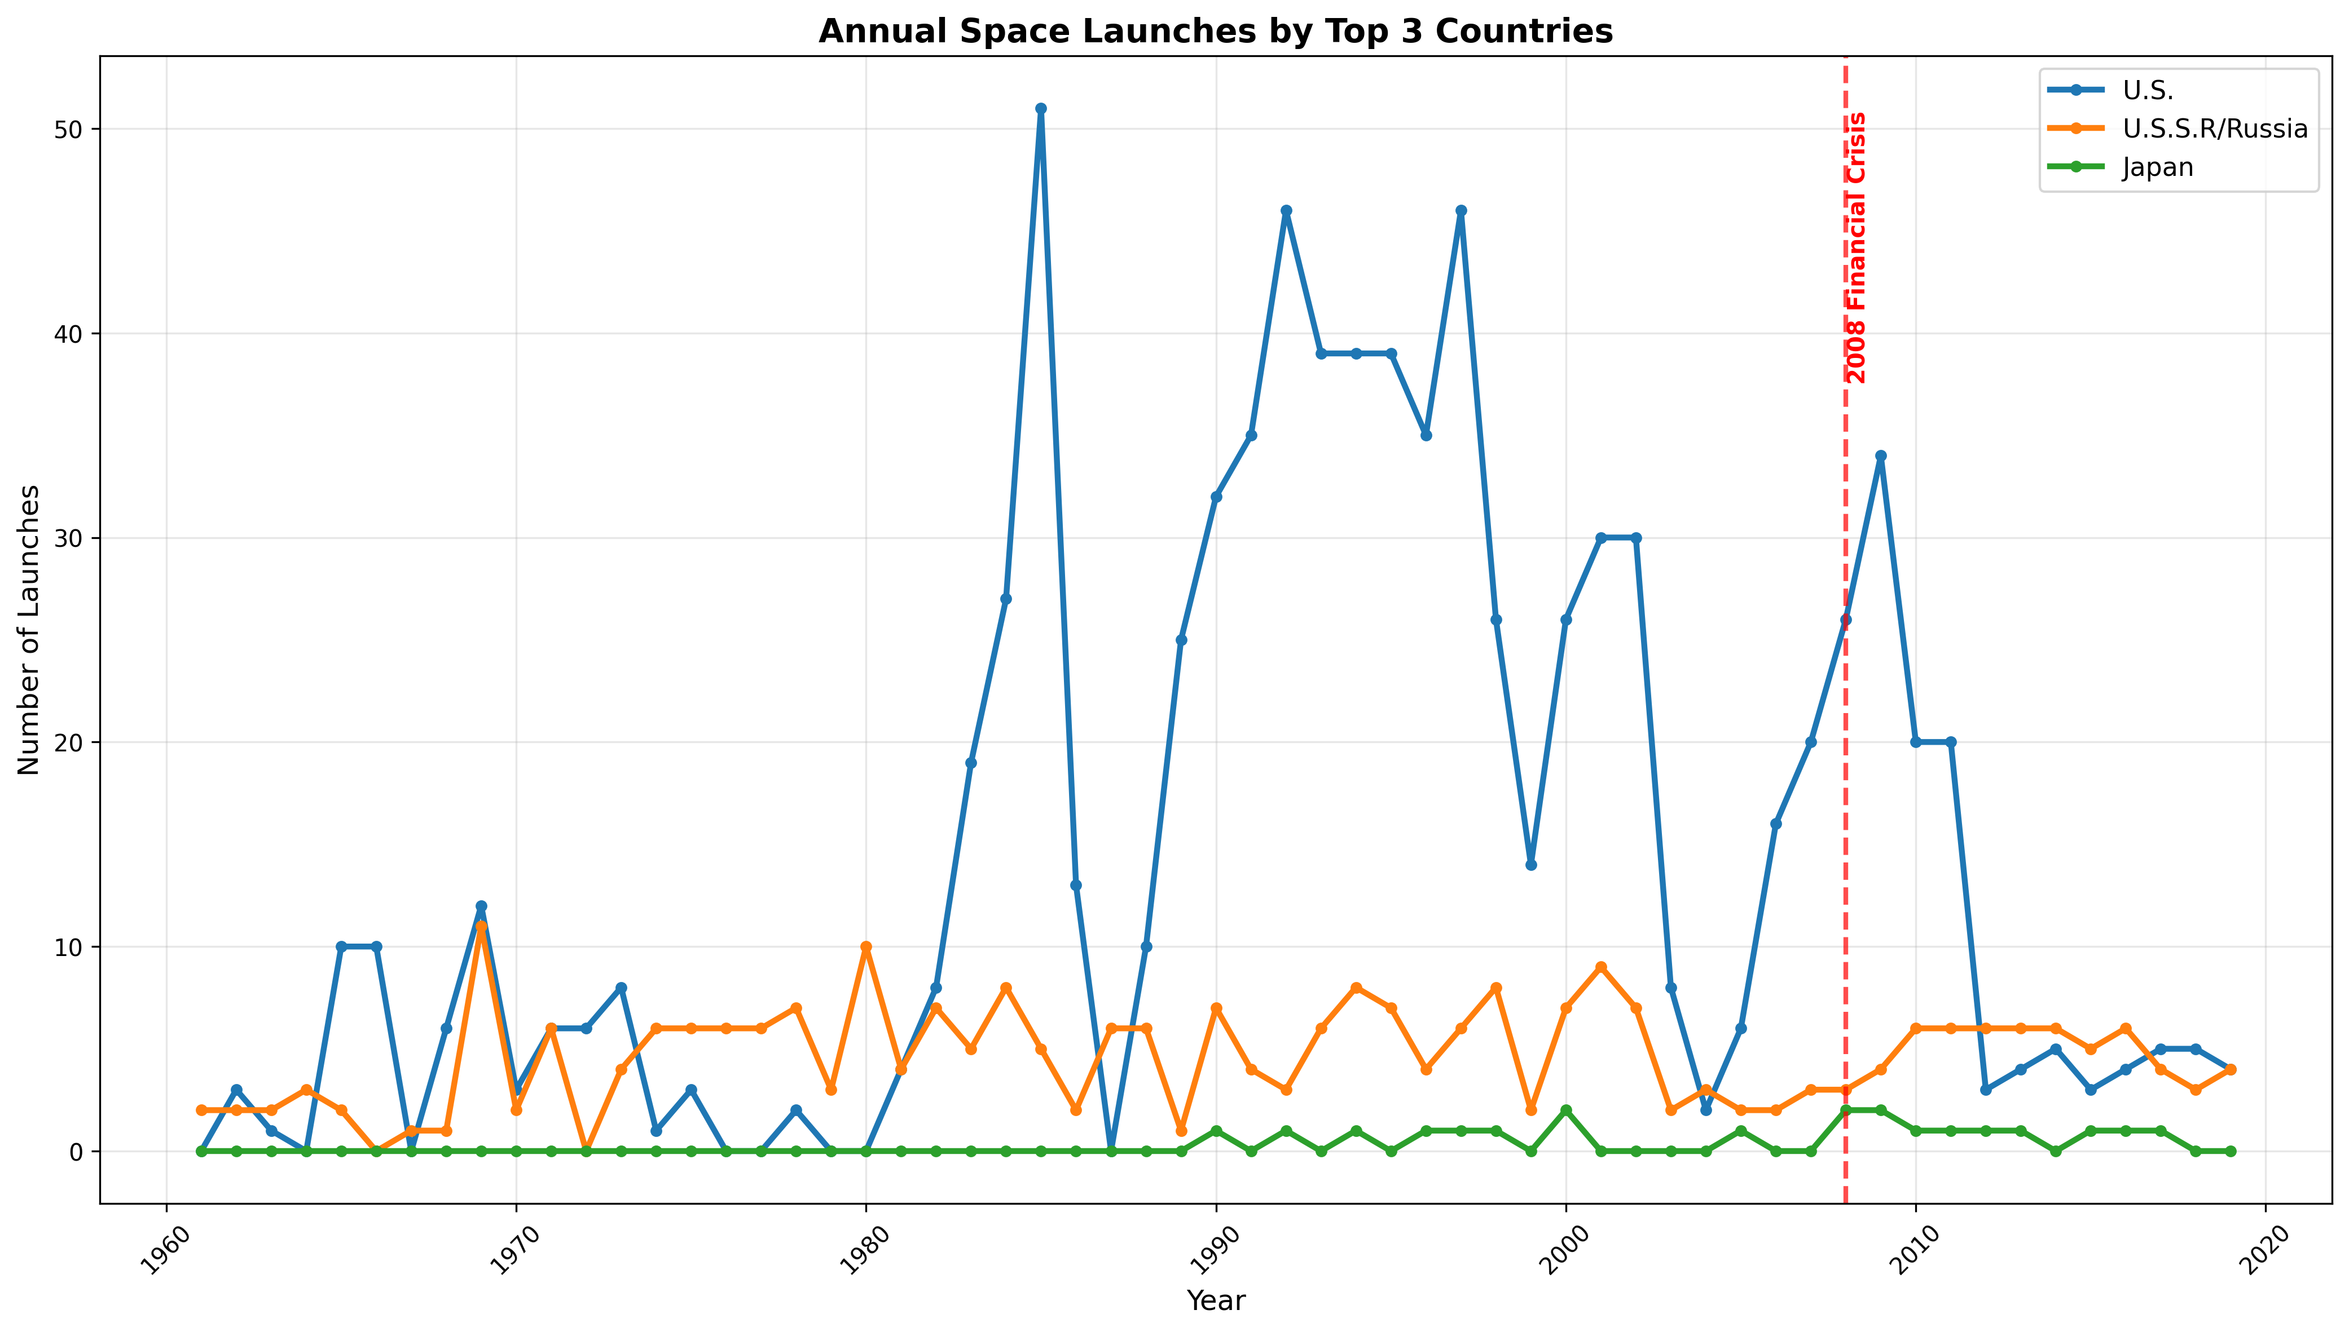
Launch V.S. Price level

Slide 8
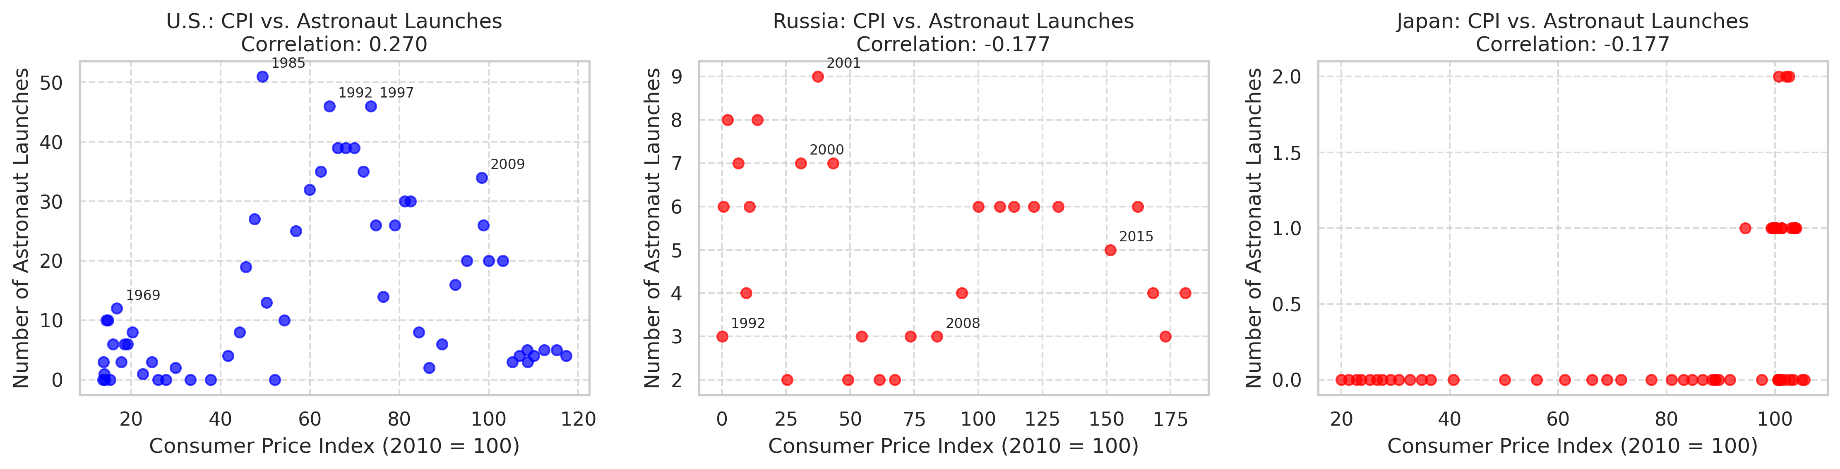
Launch V.S. Price level

Slide 9
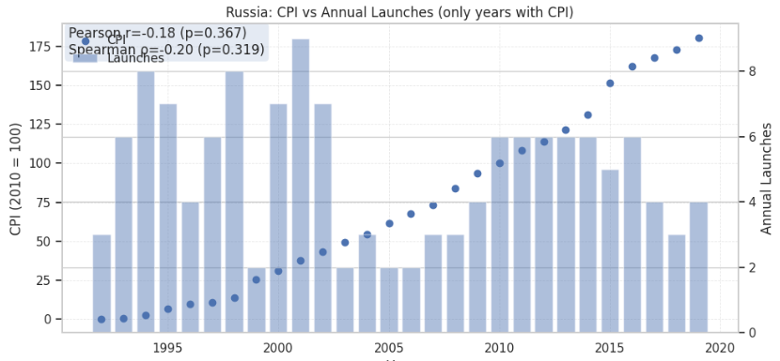
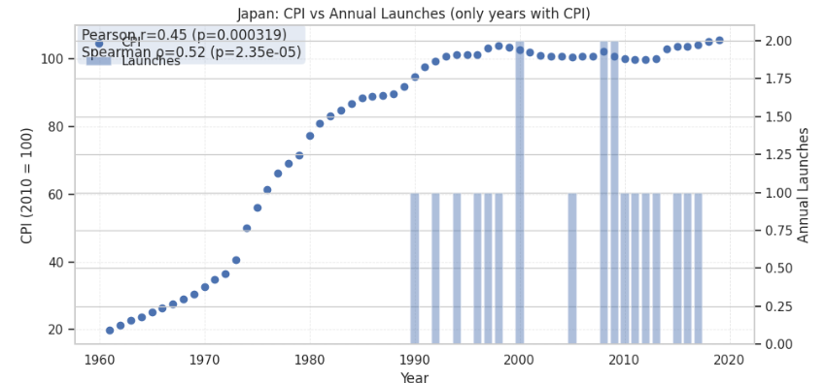
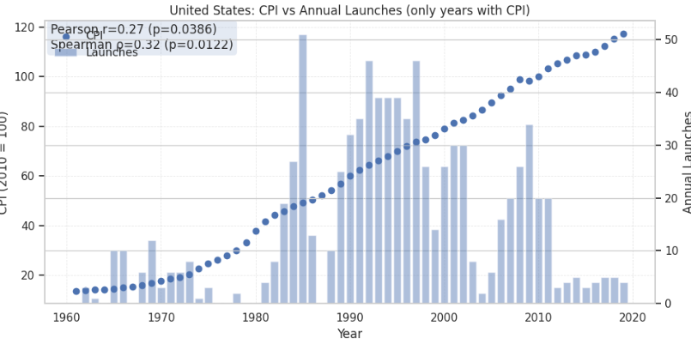
Launches V.S. Price level

Slide 10
International cooperation
Outcome
Cooperation networks reveal that U.S., Russia, and Japan are the top three most connected and most active launch countries.
Their centrality reflects the shift from competition (Cold War) to cooperation (ISS era).
Smaller countries (Canada, European states, etc.) often appear only through cooperation, reinforcing its importance for access to space.

Slide 11
CPI vs Launches (RQ1)
Outcome
United States: CPI rises steadily, launches fluctuate with political/technological eras. Weak correlation (Pearson r=0.27).
Russia: Despite post-Soviet inflation crises, launch activity continued. Correlation insignificant (r≈−0.18).
Japan: Shows a moderate positive correlation (r≈0.45), but still space investment does not decline when living costs rise

Slide 12
Finding
Cooperation, not competition, sustains space progress – our cooperation network shows that the most successful spacefaring nations are also those most engaged in international partnerships.
Space programs are politically and strategically motivated – not directly responsive to citizens’ financial struggles.

Slide 13
End Slide Navy

